Slide 1
C++ is Fun – Part 15 at Turbine/Warner Bros.!
Russell Hanson

Slide 2
Syllabus
1) First program and introduction to data types and control structures with applications for games learning how to use the programming environment Mar 25-27
2) Objects, encapsulation, abstract data types, data protection and scope April 1-3
3) Basic data structures and how to use them, opening files and performing operations on files – April 8-10
4) Algorithms on data structures, algorithms for specific tasks, simple AI and planning type algorithms, game AI algorithms April 15-17
Project 1 Due – April 17
5) More AI: search, heuristics, optimization, decision trees, supervised/unsupervised learning – April 22-24
6) Game API and/or event-oriented programming, model view controller, map reduce filter – April 29, May 1
7) Basic threads models and some simple databases SQLite May 6-8
8) Graphics programming, shaders, textures, 3D models and rotations May 13-15
Project 2 Due May 15
9) Threads, Atomic, and Exceptions, more May 20
10) Gesture recognition & depth controllers like the Microsoft Kinect, Network Programming & TCP/IP, OSC May 27
11) Selected Topics June 3
12) Working on student projects - June 10
Final project presentations Project 3/Final Project Due June 10

Slide 3
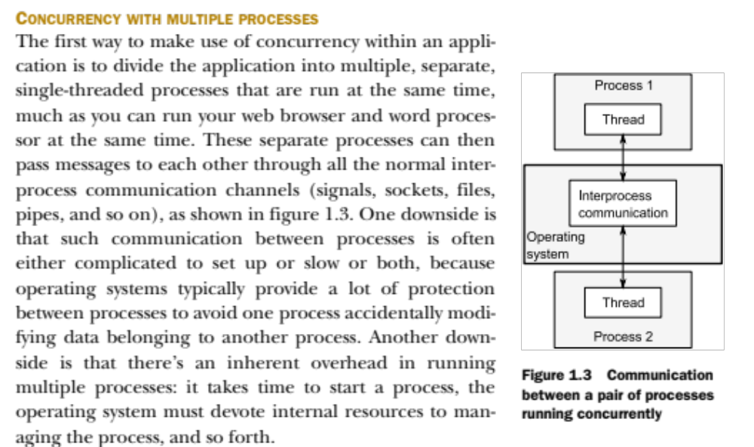

Slide 4
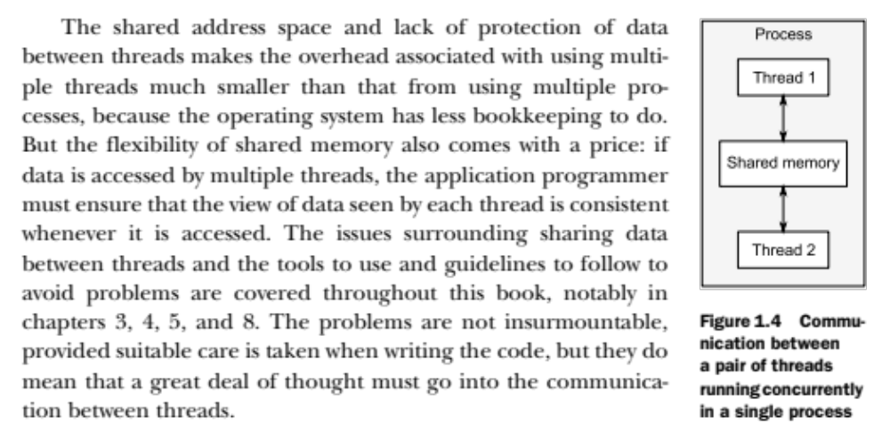

Slide 5
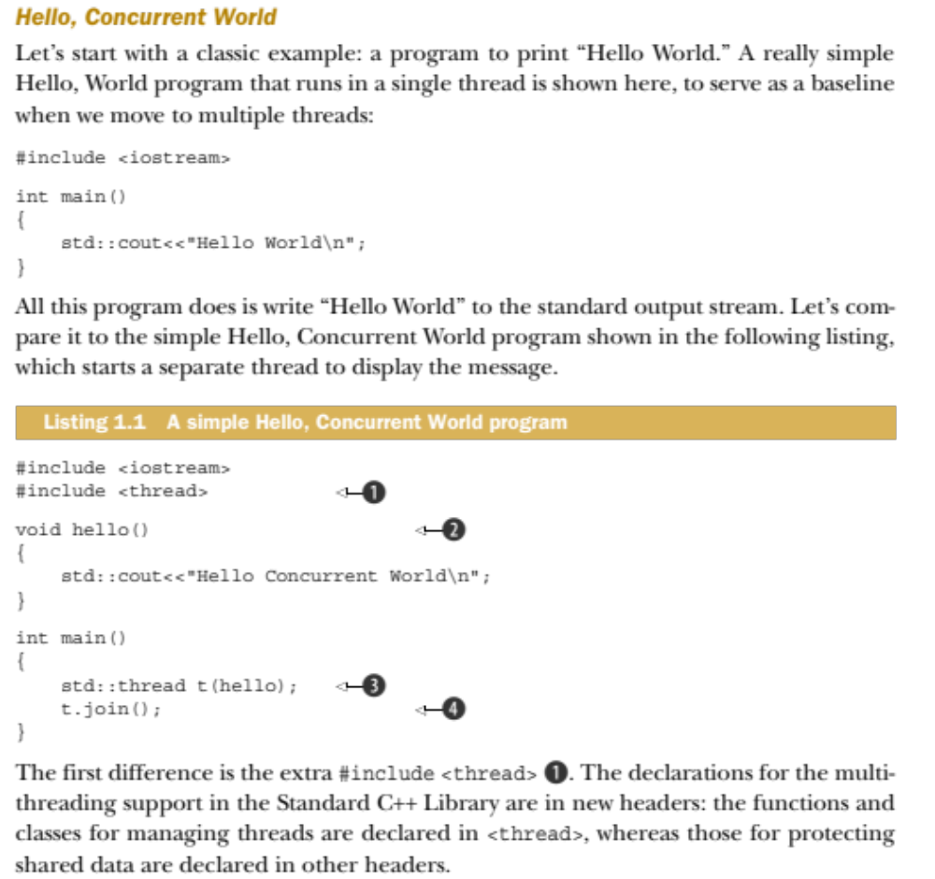

Slide 6
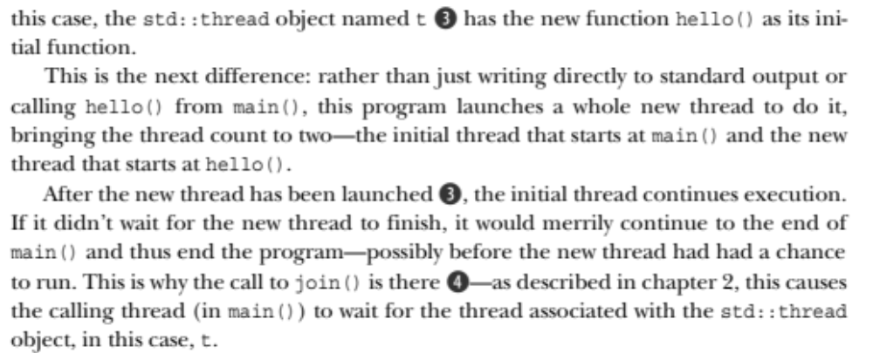

Slide 7
Class Exercise, join a thread
#include <iostream>
#include <thread>
// int main() {
// std::cout<<"Hello World\n";
// }
void hello(){
std::cout<<"Hello Concurrent World\n";
}
int main() {
std::thread t(hello);
t.join();
}
Hello Concurrent World

Slide 8
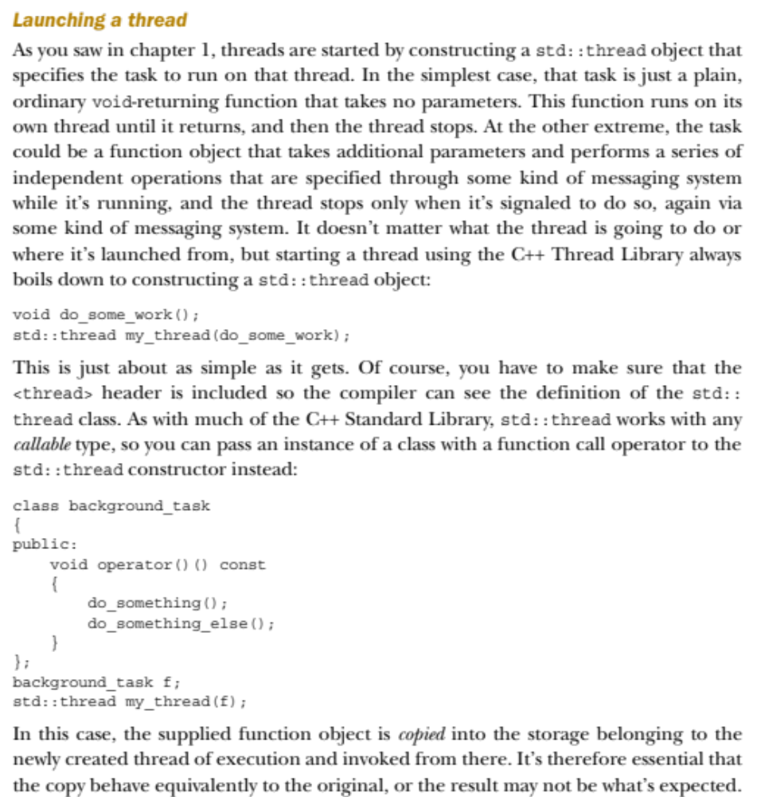

Slide 9
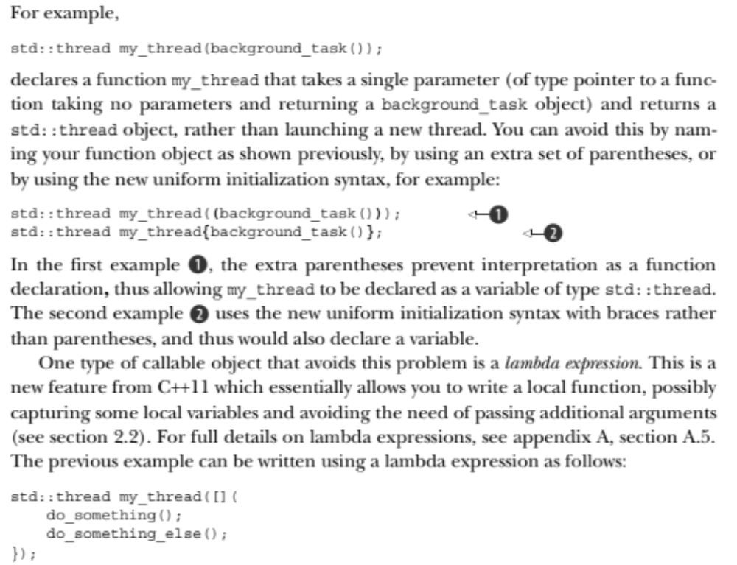

Slide 10
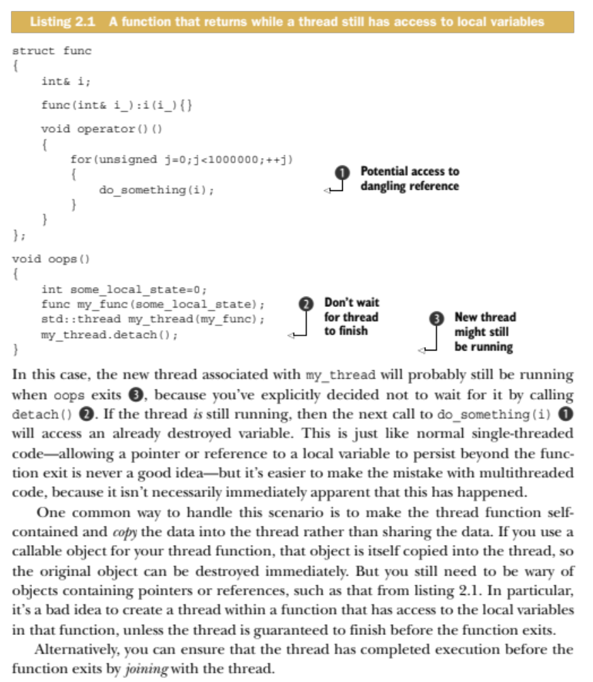

Slide 11
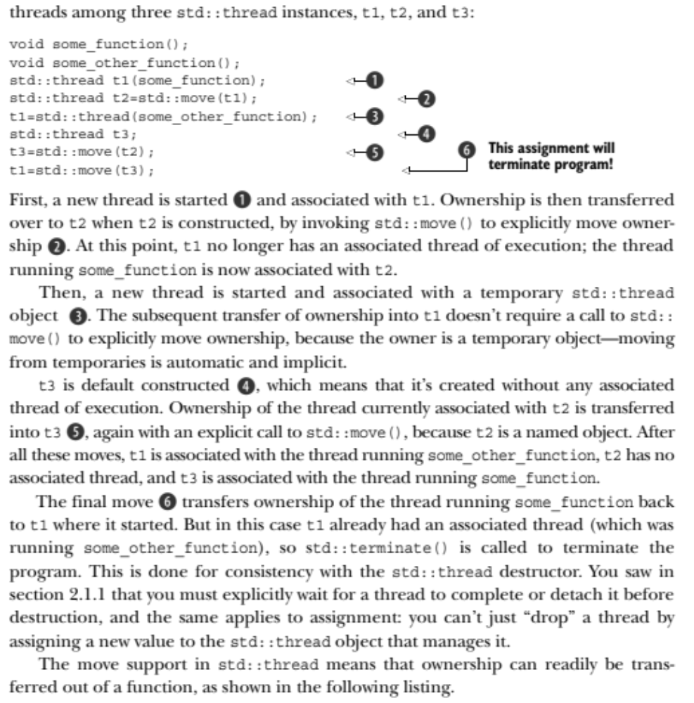
Transferring ownership of a thread

Slide 12
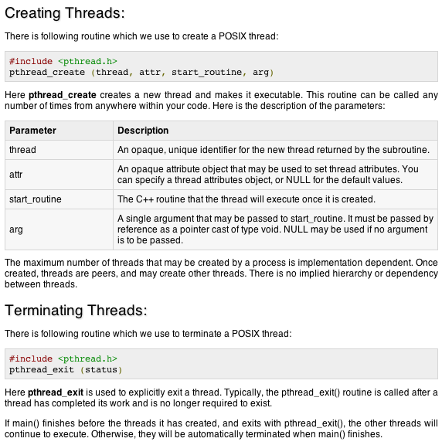
Pthreads is another alternative

Slide 13
#include <iostream>
#include <pthread.h>
using namespace std;
#define NUM_THREADS 5
void *PrintHello(void *threadid)
{
long tid;
tid = (long)threadid;
cout << "Hello World! Thread ID, " << tid << endl;
pthread_exit(NULL);
}
int main ()
{
pthread_t threads[NUM_THREADS];
int rc;
int i;
for( i=0; i < NUM_THREADS; i++ ){
cout << "main() : creating thread, " << i << endl;
rc = pthread_create(&threads[i], NULL,
PrintHello, (void *)i);
if (rc){
cout << "Error:unable to create thread," << rc << endl;
exit(-1);
}
}
pthread_exit(NULL);
}
Class Exercise, using pthreads
main() : creating thread, 0
main() : creating thread, 1
main() : creating thread, 2
main() : creating thread, 3
main() : creating thread, 4
Hello World! Thread ID, 0
Hello World! Thread ID, 1
Hello World! Thread ID, 2
Hello World! Thread ID, 3
Hello World! Thread ID, 4

Slide 14
#include <iostream>
#include <pthread.h>
using namespace std;
#define NUM_THREADS 5
struct thread_data{
int thread_id;
char *message;
};
void *PrintHello(void *threadarg)
{
struct thread_data *my_data;
my_data = (struct thread_data *) threadarg;
cout << "Thread ID : " << my_data->thread_id ;
cout << " Message : " << my_data->message << endl;
pthread_exit(NULL);
}
int main ()
{
pthread_t threads[NUM_THREADS];
struct thread_data td[NUM_THREADS];
int rc;
int I;
for( i=0; i < NUM_THREADS; i++ ){
cout <<"main() : creating thread, " << i << endl;
td[i].thread_id = i;
td[i].message = "This is message";
rc = pthread_create(&threads[i], NULL,
PrintHello, (void *)&td[i]);
if (rc){
cout << "Error:unable to create thread," << rc << endl;
exit(-1);
}
}
pthread_exit(NULL);
}
Passing Arguments to Threads
main() : creating thread, 0
main() : creating thread, 1
main() : creating thread, 2
main() : creating thread, 3
main() : creating thread, 4
Thread ID : 1 Message : This is message
Thread ID : 0 Message : This is message
Thread ID : 2 Message : This is message
Thread ID : 3 Message : This is message
Thread ID : 4 Message : This is message

Slide 15
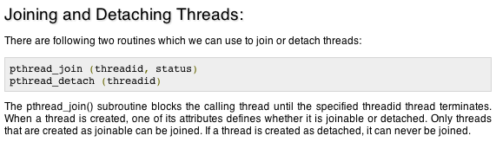

Slide 16
#include <iostream>
#include <pthread.h>
using namespace std;
#define NUM_THREADS 5
void *wait(void *t)
{
int i;
long tid;
tid = (long)t;
sleep(1); //
cout << "Sleeping in thread " << endl;
cout << "Thread with id : " << tid << " ...exiting " << endl;
pthread_exit(NULL);
}
int main ()
{
int rc;
int i;
pthread_t threads[NUM_THREADS];
pthread_attr_t attr;
void *status;
// Initialize and set thread joinable
pthread_attr_init(&attr);
pthread_attr_setdetachstate(&attr, PTHREAD_CREATE_JOINABLE);
for( i=0; i < NUM_THREADS; i++ ){
cout << "main() : creating thread, " << i << endl;
rc = pthread_create(&threads[i], NULL, wait, (void *)i );
if (rc){
cout << "Error:unable to create thread," << rc << endl;
exit(-1);
}
}
// free attribute and wait for the other threads
pthread_attr_destroy(&attr);
for( i=0; i < NUM_THREADS; i++ ){
rc = pthread_join(threads[i], &status);
if (rc){
cout << "Error:unable to join," << rc << endl;
exit(-1);
}
cout << "Main: completed thread id :" << i ;
cout << " exiting with status :" << (int)status << endl;
}
cout << "Main: program exiting." << endl;
pthread_exit(NULL);
}
// free attribute and wait for the other threads
pthread_attr_destroy(&attr);
for( i=0; i < NUM_THREADS; i++ ){
rc = pthread_join(threads[i], &status);
if (rc){
cout << "Error:unable to join," << rc << endl;
exit(-1);
}
cout << "Main: completed thread id :" << i ;
cout << " exiting with status :" << (int)status << endl;
}
cout << "Main: program exiting." << endl;
pthread_exit(NULL);
}
main() : creating thread, 0
main() : creating thread, 1
main() : creating thread, 2
main() : creating thread, 3
main() : creating thread, 4
Sleeping in thread
Thread with id : 0 ...exiting
Sleeping in thread
Thread with id : 1 ...exiting
Sleeping in thread
Thread with id : 2 ...exiting
Sleeping in thread
Thread with id : 3 ...exiting
Sleeping in thread
Thread with id : 4 ...exiting

Slide 17
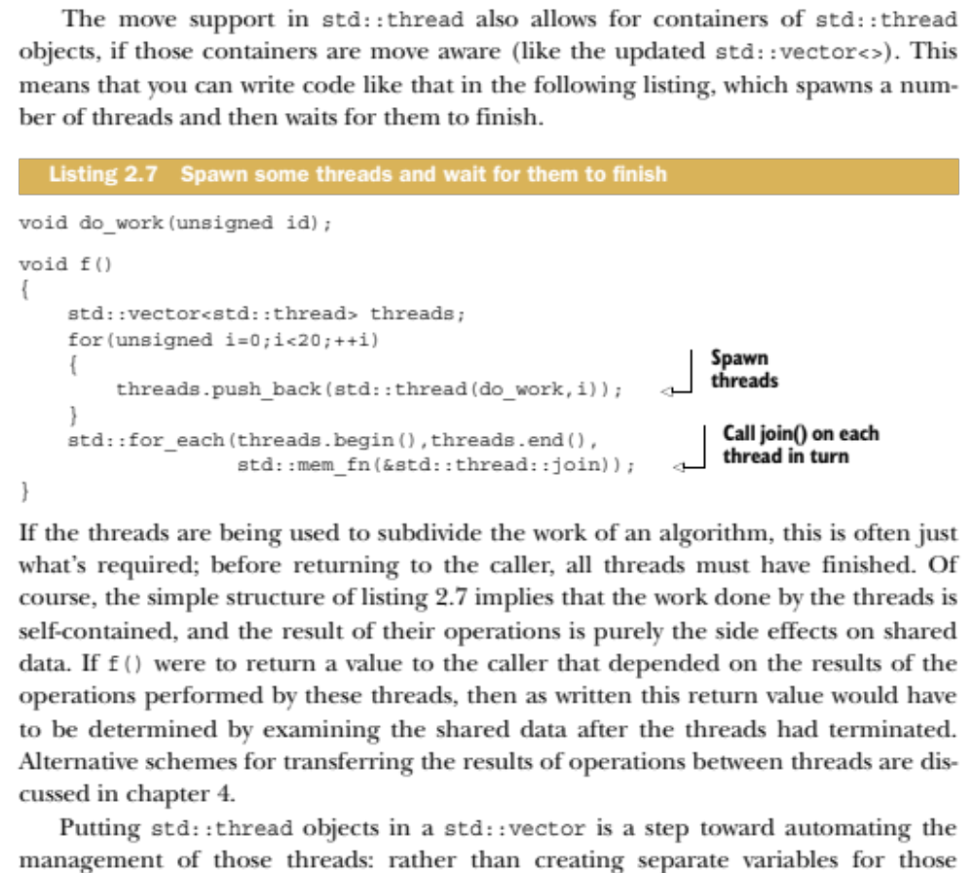

Slide 18
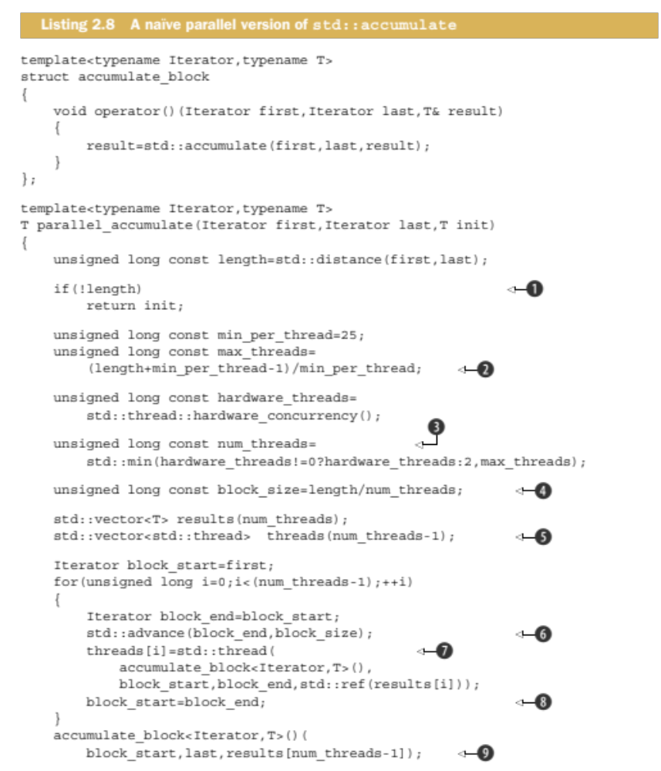
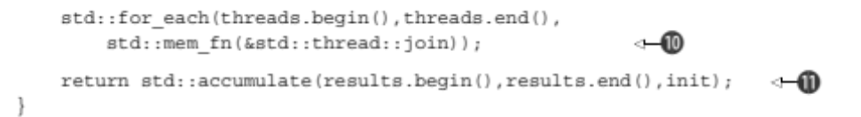

Slide 19
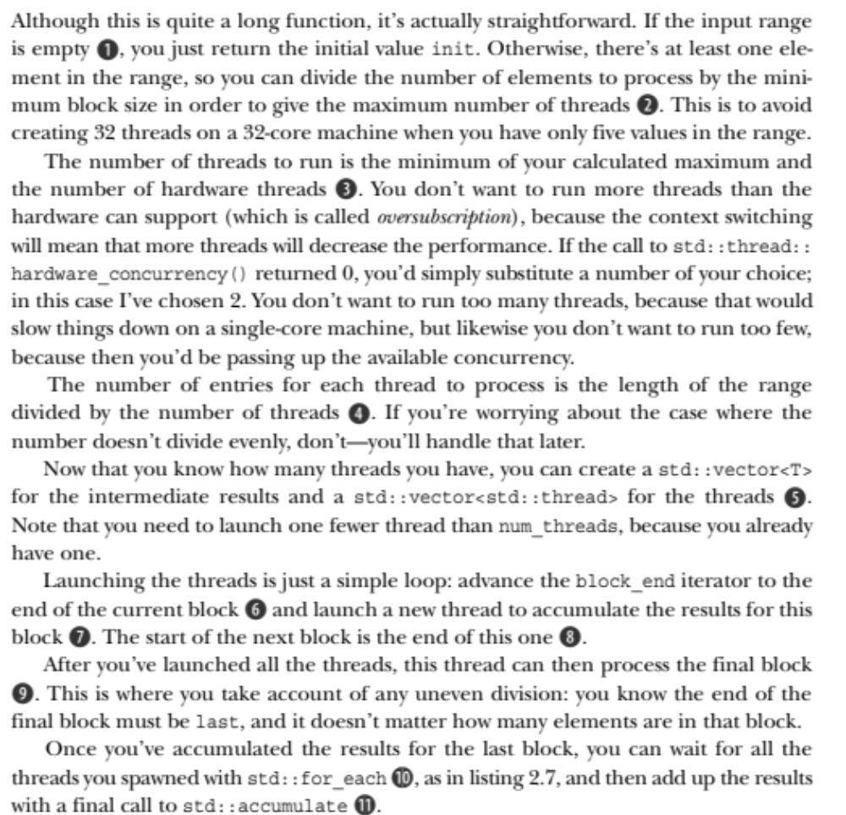
And the bullet-point by bullet-point explanation/elaboration

Slide 20
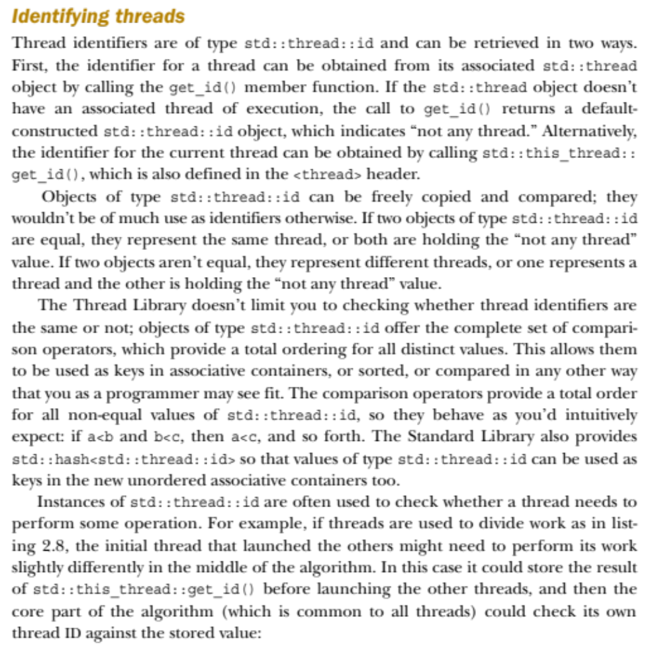
Thread Identifiers

Slide 21
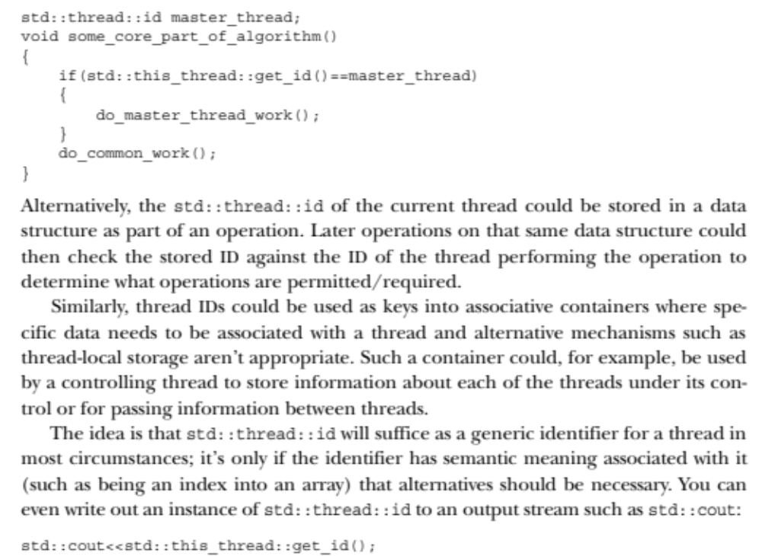
Thread Identifiers

Slide 22
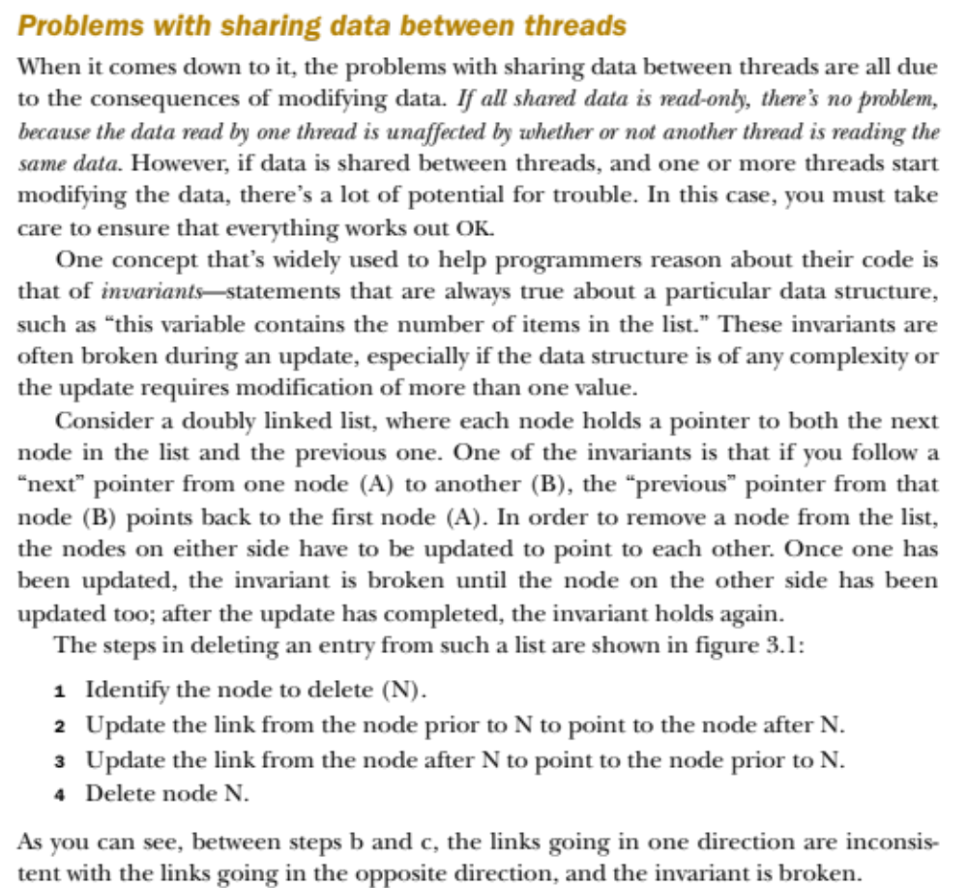

Slide 23
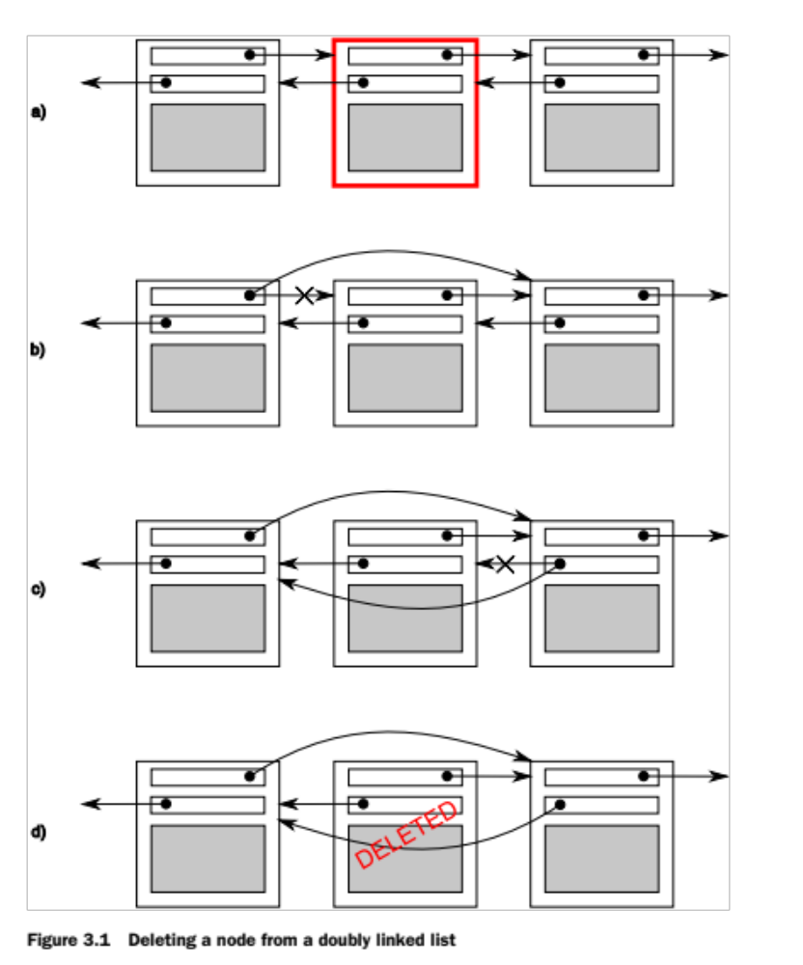

Slide 24
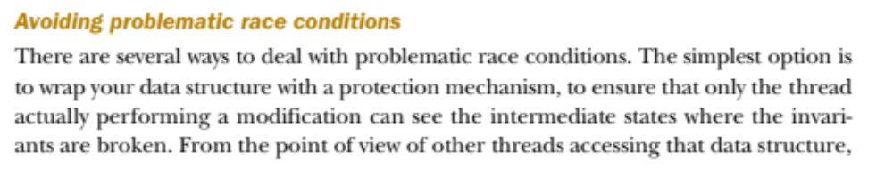
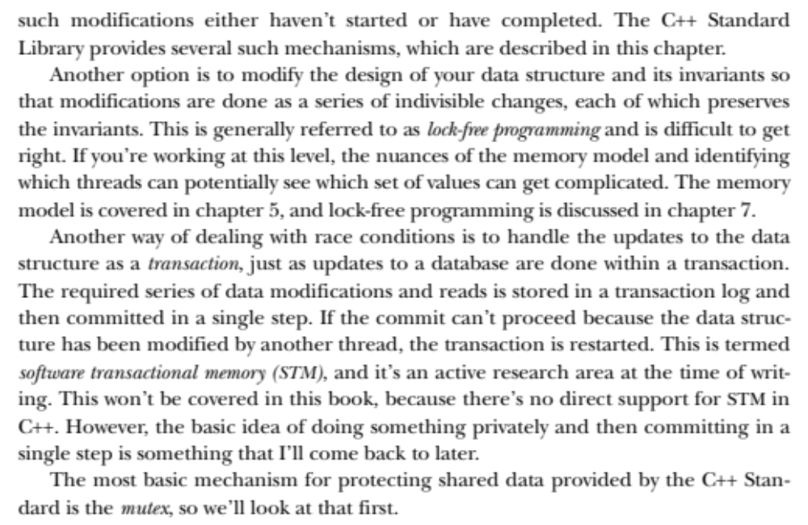

Slide 25
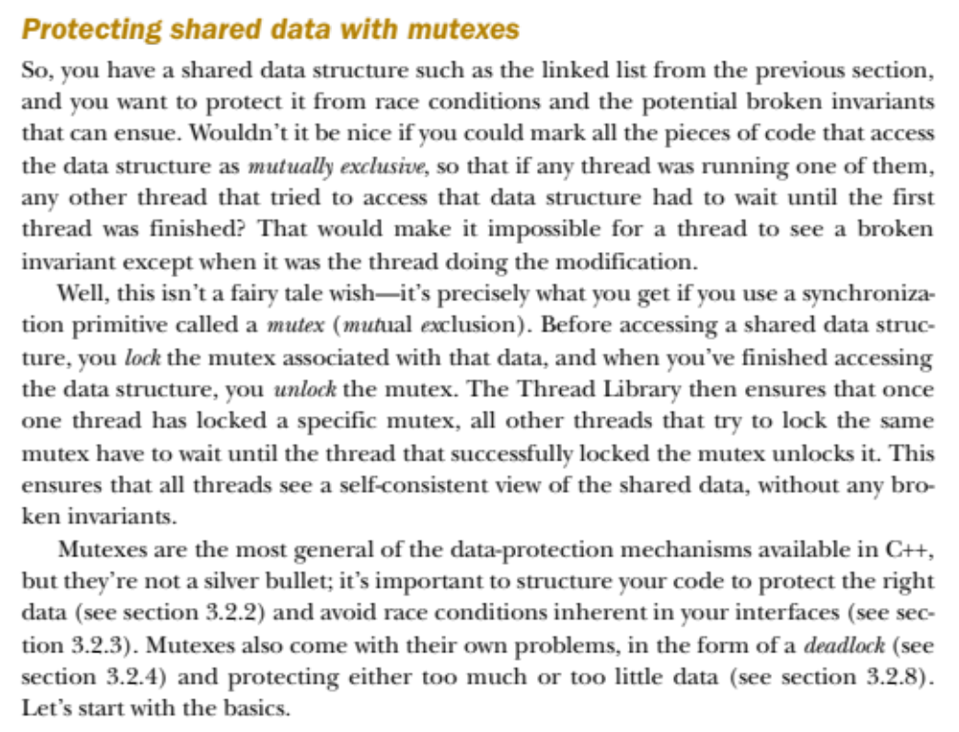
mutex – mutual exclusion

Slide 26
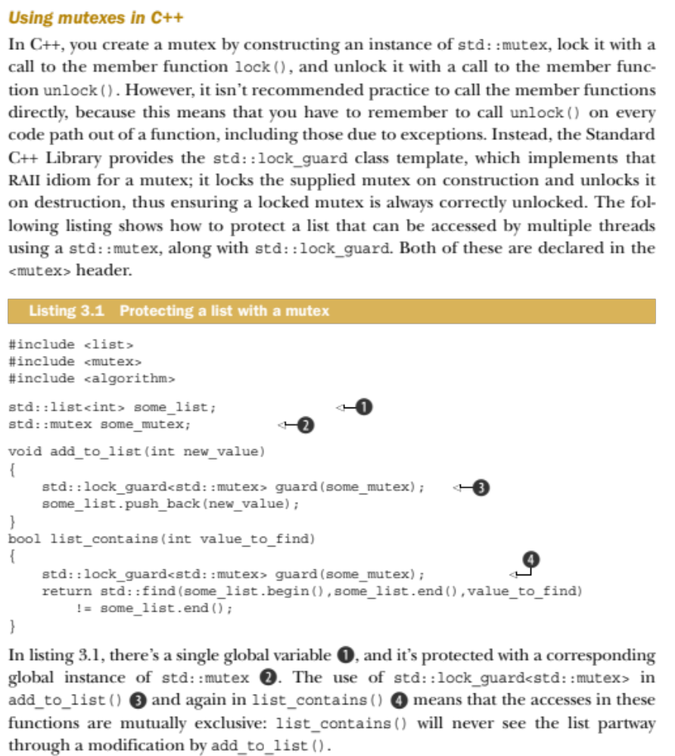

Slide 27
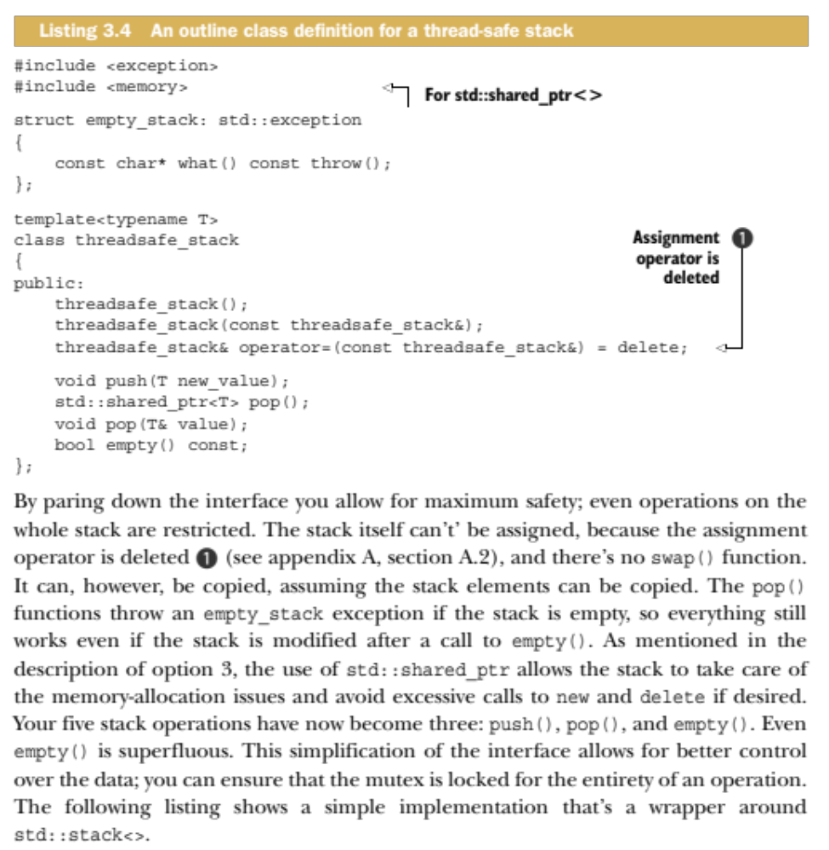

Slide 28
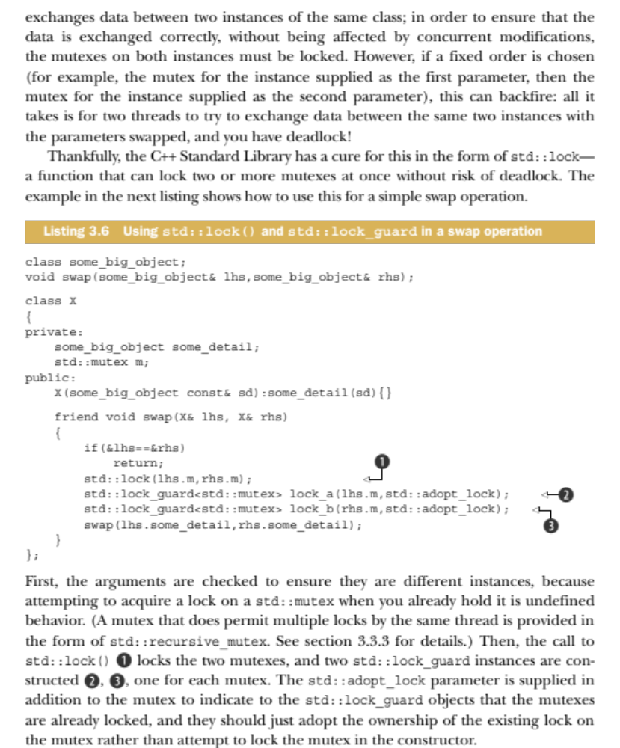

Slide 29
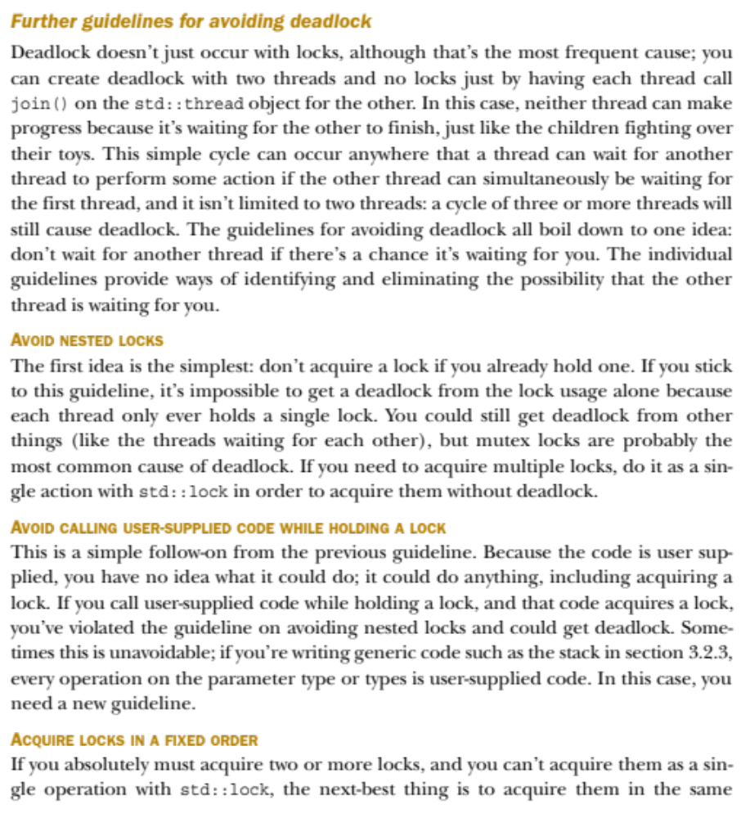

Slide 30
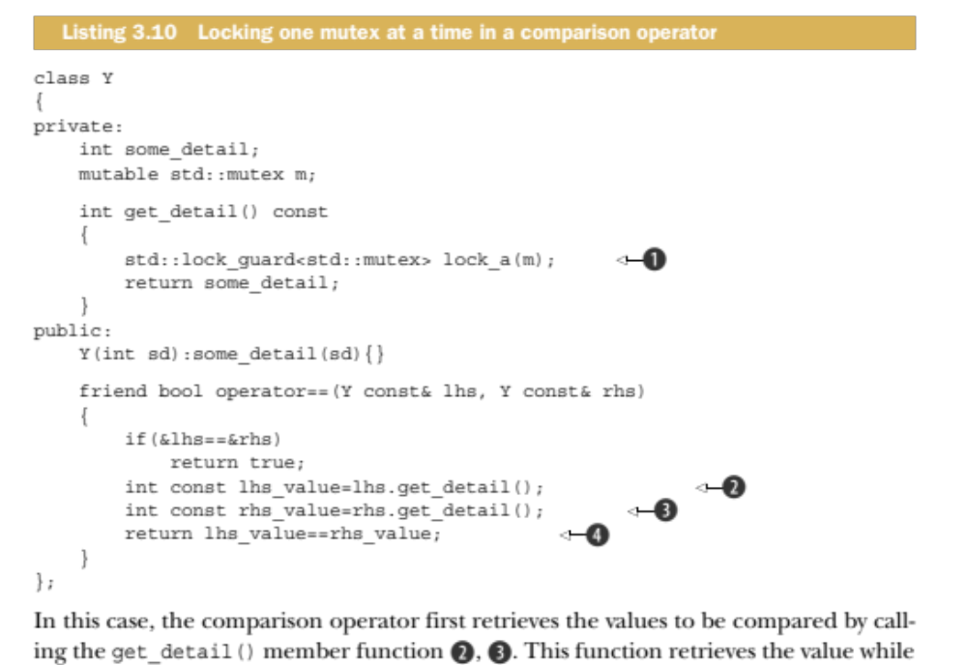
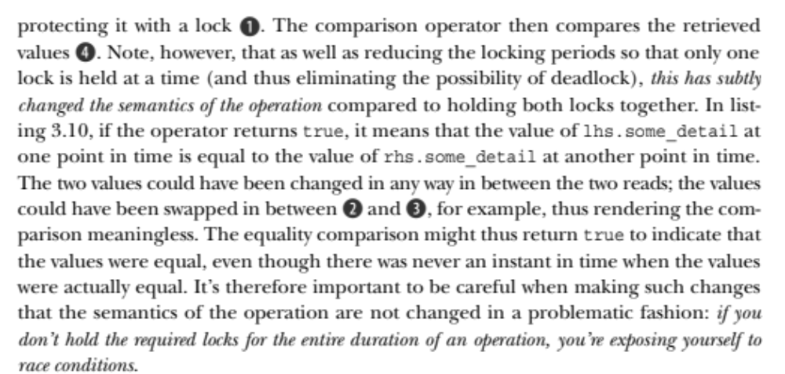

Slide 31
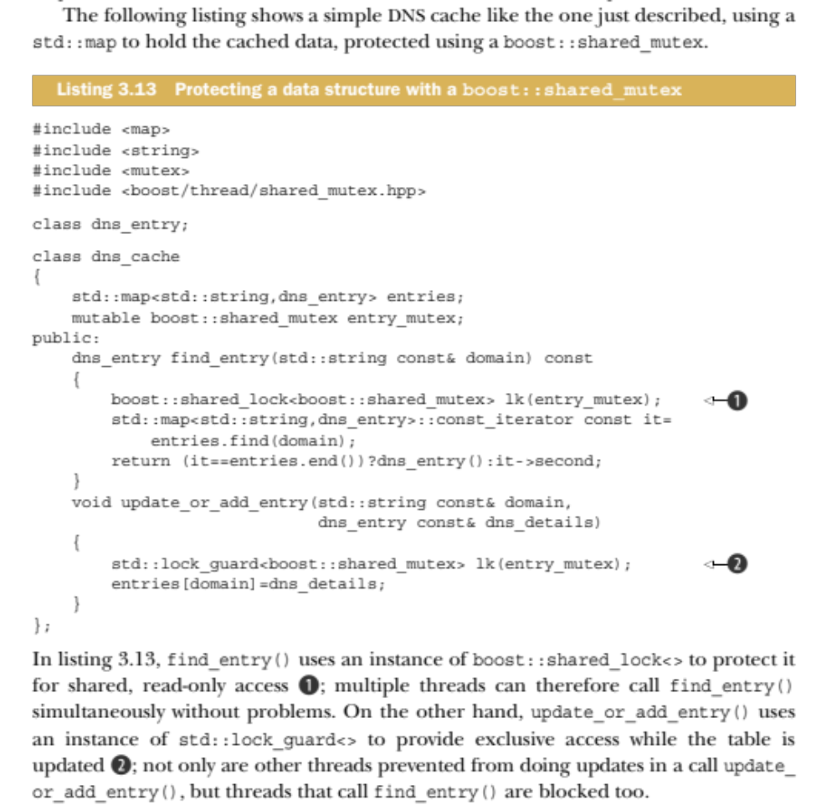

Slide 32
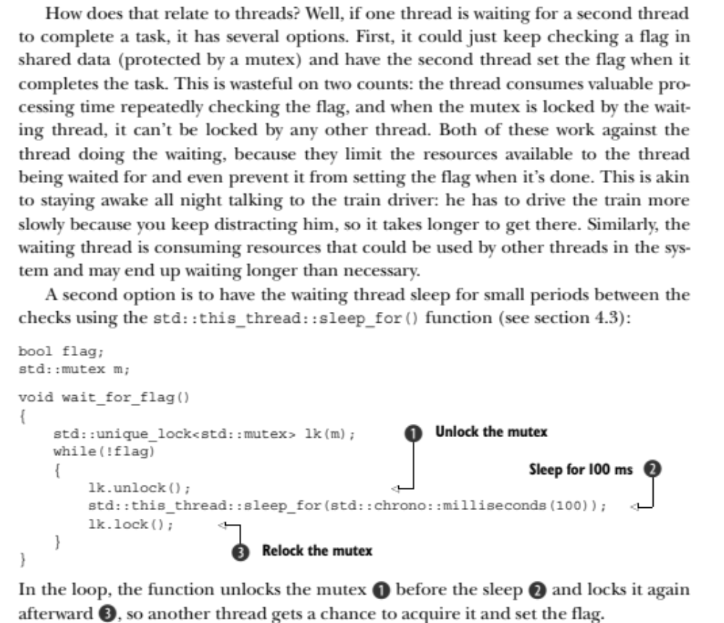

Slide 33
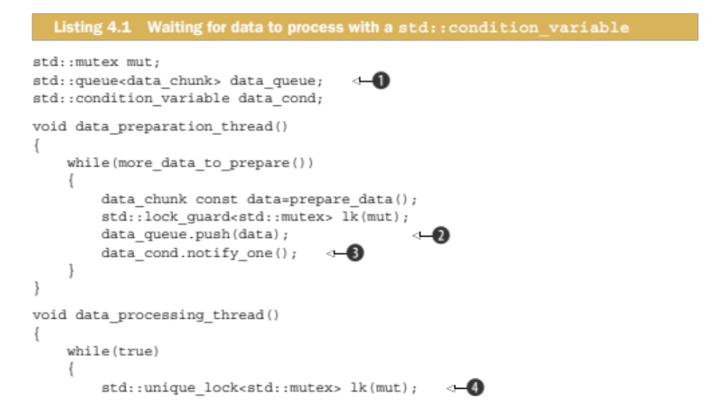
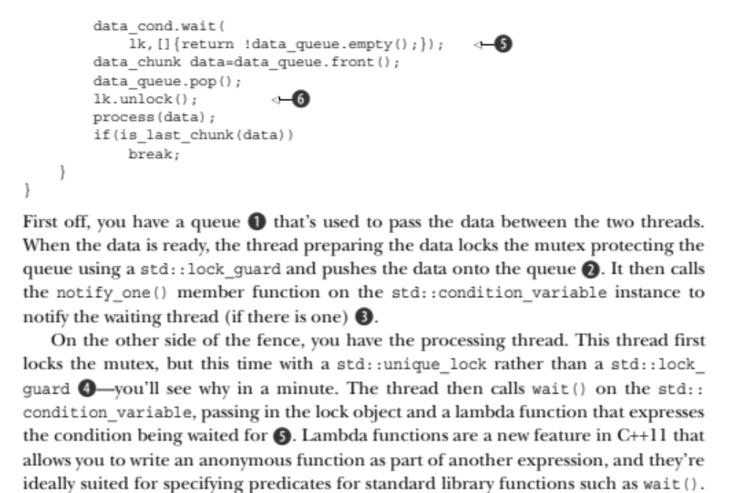

Slide 34
On Windows, setting threads for each processor
#define WIN32_LEAN_AND_MEAN
#include <windows.h>
#include <stdio.h>
HANDLE *m_threads = NULL;
DWORD_PTR WINAPI threadMain(void* p);
DWORD_PTR GetNumCPUs() {
SYSTEM_INFO m_si = {0, };
GetSystemInfo(&m_si);
return (DWORD_PTR)m_si.dwNumberOfProcessors;
}
int wmain(int argc, wchar_t **args) {
DWORD_PTR c = GetNumCPUs();
m_threads = new HANDLE[c];
for(DWORD_PTR i = 0; i < c; i++) {
DWORD_PTR m_id = 0;
DWORD_PTR m_mask = 1 << I;
m_threads[i] = CreateThread(NULL, 0, (LPTHREAD_START_ROUTINE)threadMain, (LPVOID)i, NULL, &m_id);
SetThreadAffinityMask(m_threads[i], m_mask);
wprintf(L"Creating Thread %d (0x%08x) Assigning to CPU 0x%08x\r\n", i, (LONG_PTR)m_threads[i], m_mask);
}
return 0;
}
DWORD_PTR WINAPI threadMain(void* p) {
return 0;
}

Slide 35
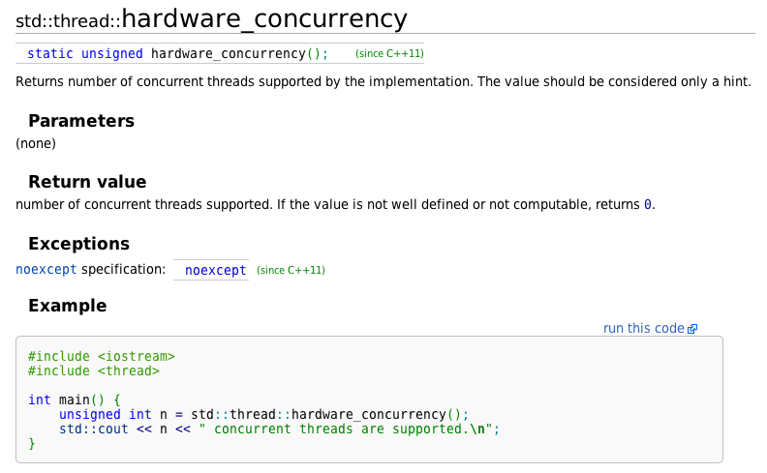
#include <iostream>
#include <thread>
int main() {
unsigned int n = std::thread::hardware_concurrency();
std::cout << n << " concurrent threads are supported.\n";
}
2 concurrent threads are supported.

Slide 36
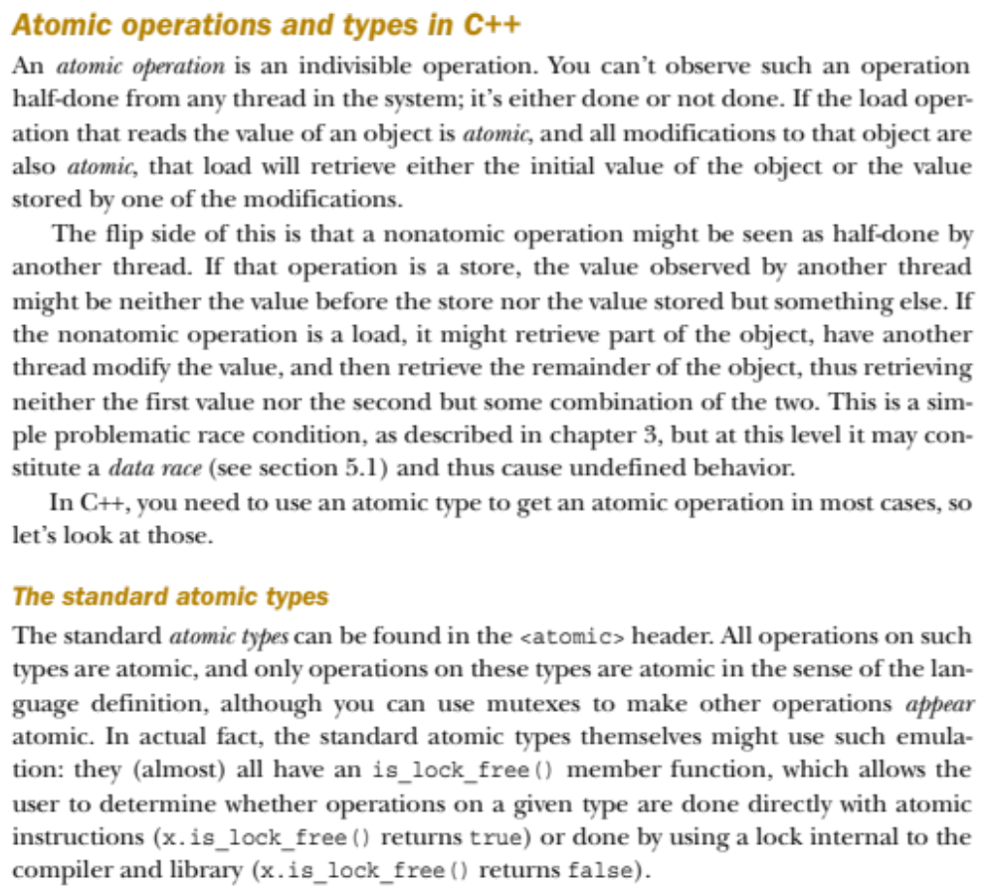
Using atomic types – indivisible operations can’t be half-done

Slide 37
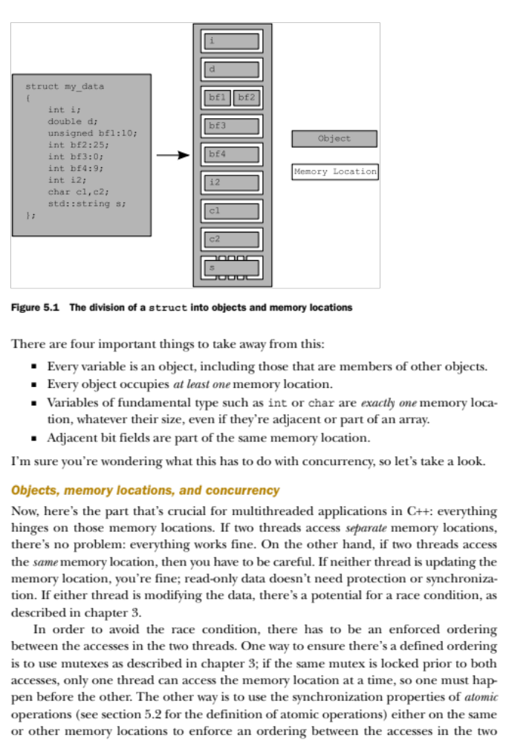

Slide 38
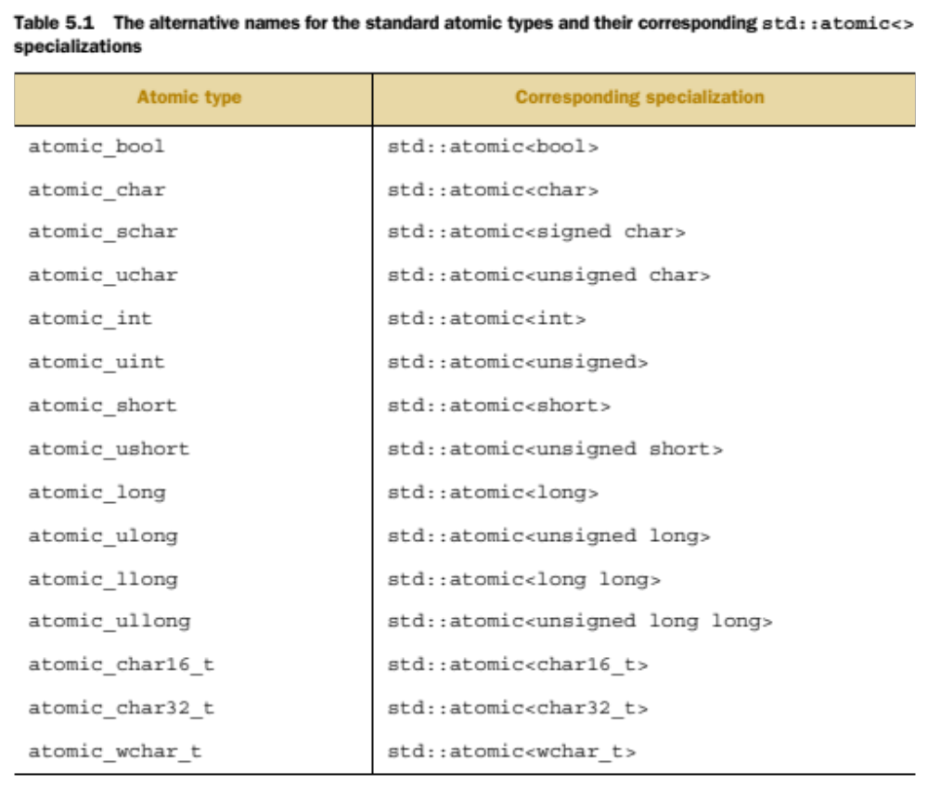

Slide 39
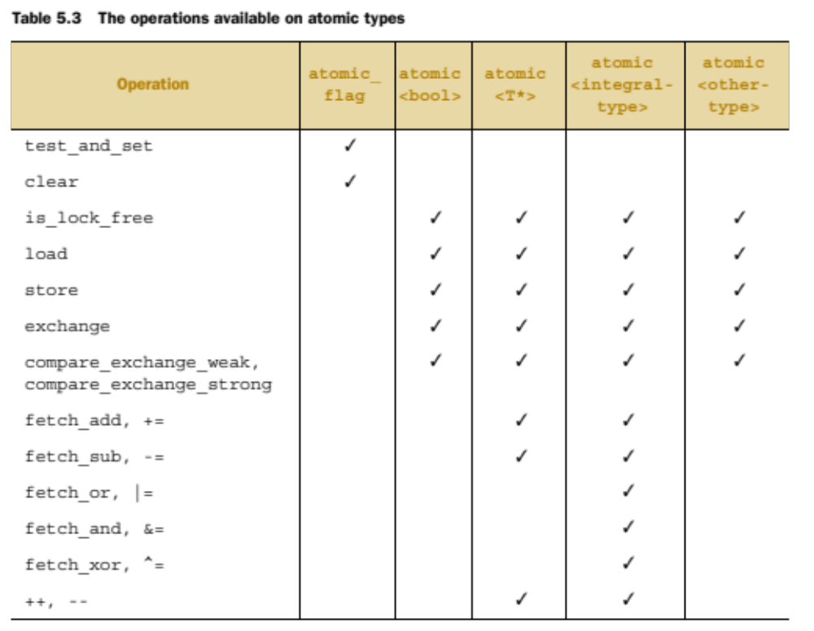

Slide 40
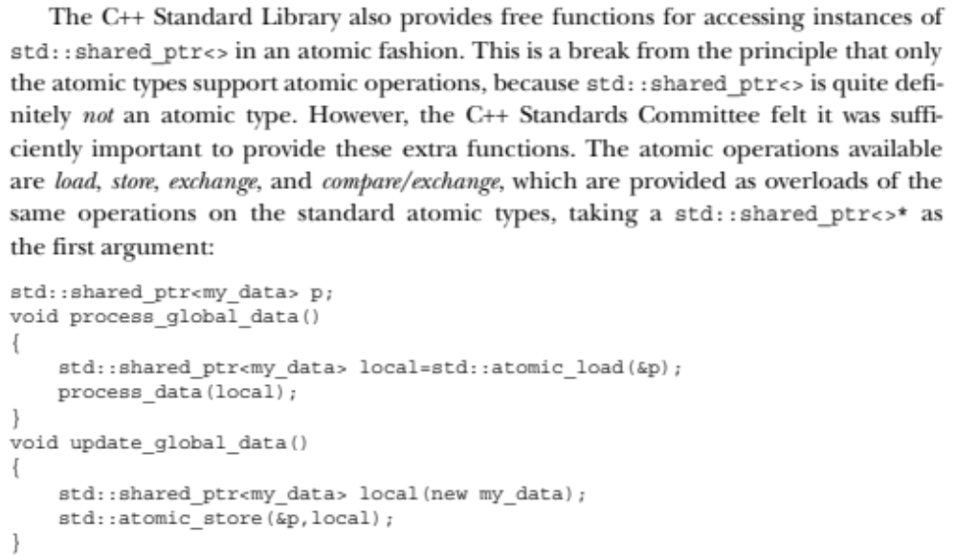

Slide 41
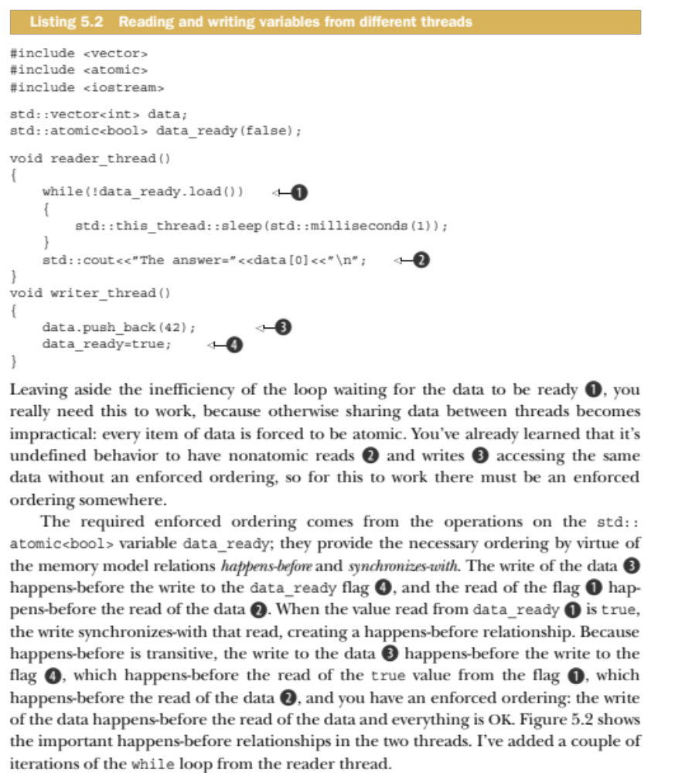

Slide 42
The simplest possible thread pool

Slide 43
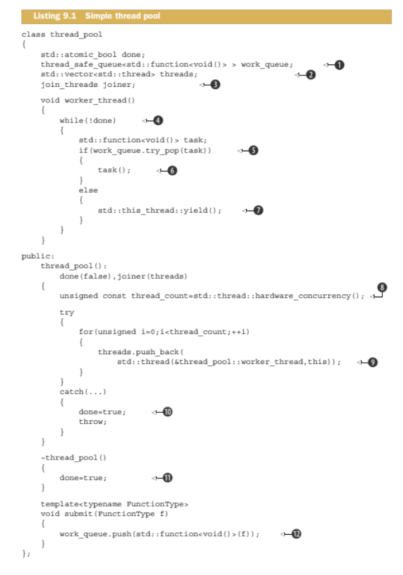

Slide 44
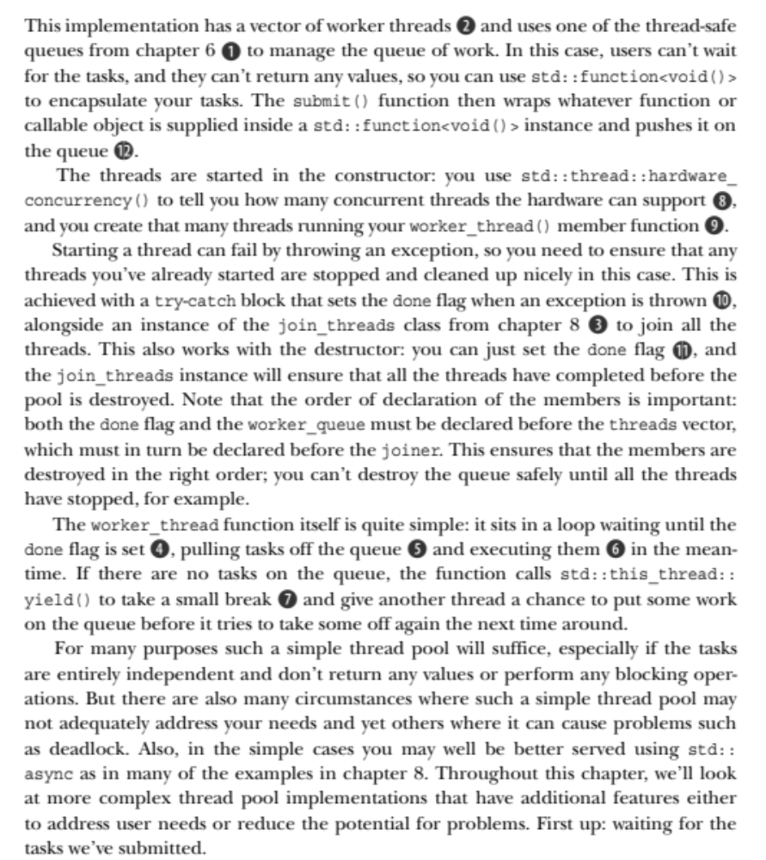

Slide 45

Next time… threadsafe Cinder Kinect!

